Slide 1
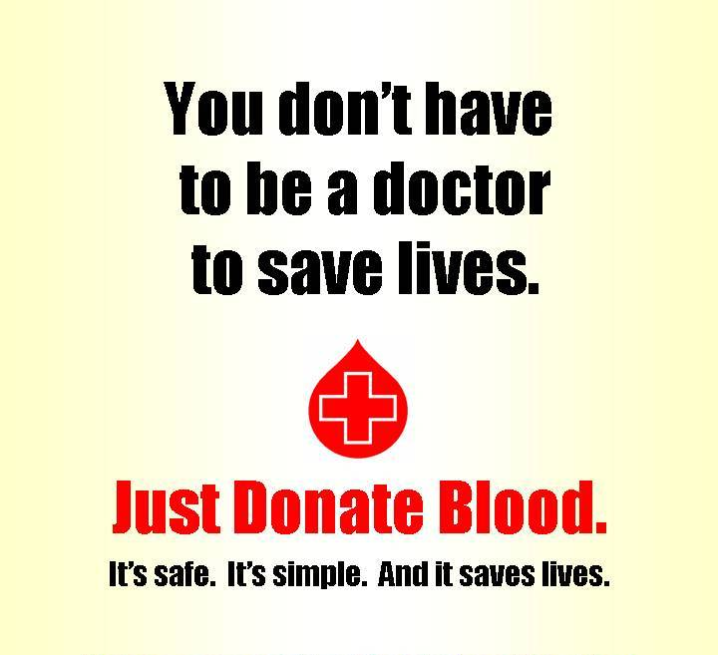
Blood donation app
By 3D-TECH
Dillesh Kumar
Mridusmith Basumatary
Himanshu Bharti

Slide 2
Features:
Location based voluntary blood donor search.
Blood donor’s registration: login, edit profile,delete profile and change password.
Donor’s contacts like phone number and address will be made available.
The details of the donor will be hidden for 3 months after the date of donation.
Feedback from users.

Slide 3
How our app is different from others?
The results will be showed based on the Body Mass Index(BMI) of the person to make sure that the person is eligible for donation of blood.
Request blood in advance. So , when a suitable donor in that particular area is available the person requesting for blood will be notified.

